Slide 1
ECMAScript 2015 (ES6)
Nov 2016

Slide 2
Agenda
What is ECMAScript
ECMAScript 5 vs 6
Initialize your project
Most used features on ES6
Block-scoped Variables
Default Parameters
Template Literals
Destructuring Assignments
Enhanced Object Literals
Arrow Function
Array Declaration and Structuring
Promises
Let vs Constant
Export and Import Features

Slide 3


Slide 4
What is ECMAScript?
“ECMAScript is a subset of JavaScript. JavaScript is basically ECMAScript at its core but builds upon it.”

Slide 5
ECMAScript vs JavaScript
JavaScript core language is defined on a standard called ECMA-262, but hadn’t changed since 1999.
ECMA later is developed after the popularity of AJAX and Node.js in 2007.

Slide 6
The 1st Stable ECMAScript
ES3.1 > ES4 > ES5
Featured with:
New syntax
Modules
Classes
Classical Inheritance
Private object members

Slide 7
ES5 vs ES6
Completely new objects
New string patterns
Shorter syntax
New arrow functions
Easier array declaration
Accessing objects from other classes
Removing of semicolon ‘;’

Slide 8
Initializing your project
Run npm init to initialize package.json
Follow the tutorial to deploy ReactJS along with JSX, Babel, and ES2015.
Run npm install babel webpack webpack-dev-server –g to install Webpack.
Run your server with npm start.

Slide 9
Trying the ES6
We will create ES6 classes, methods/functions, and objects in App.js.
Implement the created classes, methods, and objects inside the render() method in class App.

Slide 10
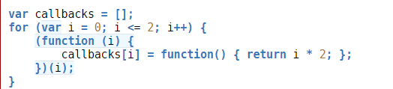

Block-scoped Variables
Unlimited use of variables scoped to a block.
ES5
ES6

Slide 11
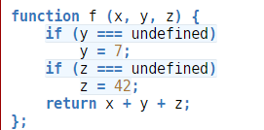

Default Parameters
Default values in the function parameters and object declaration
ES5:
ES6:

Slide 12
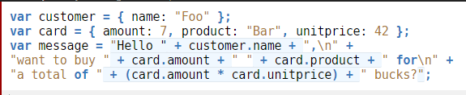
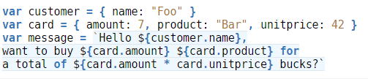
Template Literals
String interpolation between single-line and multi-line strings.
ES5:
ES6:

Slide 13


Destructuring Assignments
Intuitive destructuring objects into individual variables during assignment
ES5:
ES6:

Slide 14
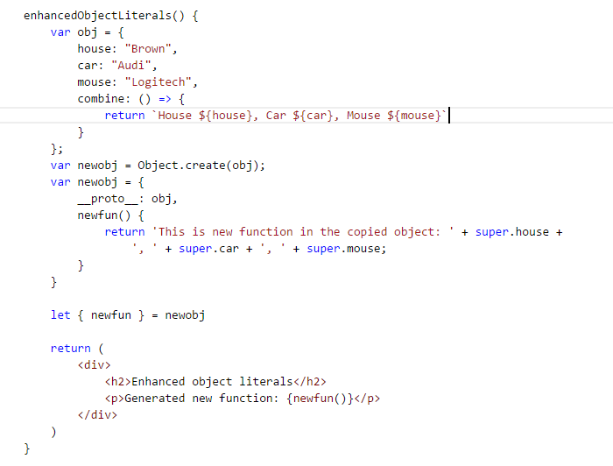
Enhanced Object Literals
Inherit objects from another object
ES6:

Slide 15

Array Declaration and Structuring
Easier array declaration, joining, and structuring
Usage can be vary: insertion, deletion, update
ES6:

Slide 16
Arrow Function
Easier array mapping
Easier method definition
Defined into two usages:
As variable
As function

Slide 17
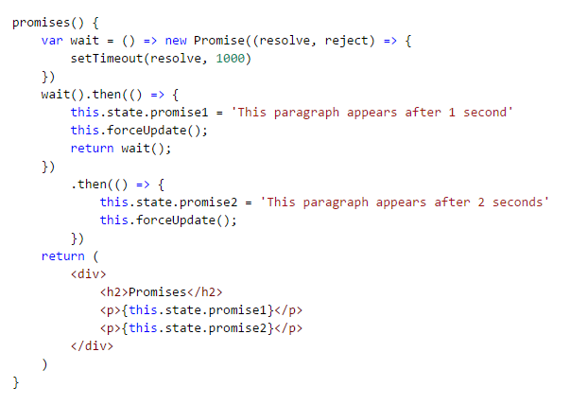
Promises
Asynchronous usage for expecting result in the future time.
ES6:

Slide 18
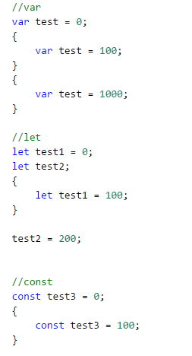
Let vs Constant
Differ usage for let and constant variable
ES6:

Slide 19
Export and Import Features
Allow you to export your classes in certain files
Import it by using import keyword
Methods/functions/variables:
Import { var1, var2, func1, func2 } from ‘../path’
Classes
Import class1, class2 from ‘../path’
Packages
Import class1, class2 from ‘packagename’
Alias
Only works for variables and functions
Import { var1 as abc } from ‘../path’

Slide 20
Looking forward…
Classes inheritance
Static members
Getter/setter
Generators
Typed variables
String type and safety checking
String formatting (number, currency, date and time)

Slide 21

Special Thanks
http://es6-features.org/
https://babeljs.io/docs/learn-es2015/
https://webapplog.com/es6/
https://leanpub.com/understandinges6/read
https://egghead.io/lessons/react-react-fundamentals-development-environment-setup?course=react-fundamentals

